Slide 1
Architecture Milestone
Software Architecture Document
  Class Diagram (all classes in your program)
  State Diagram for selected classes (at least 1)
  Sequence Diagram for selected use cases (at least 1)
Stage Delivery Plan
Software Integration Plan
Test cases for stage 1 release

Slide 2
Test Case Template
Test Case #: Pay-1 Validate that credit card
payment for POST is handled correctly
Requirements Reference R2.2
Procedure 1. Read credit card using card reader
2. Receives authorization from credit card company.
3. Acknowledge payment with the printed receipt
Success Criteria Case 1: Successful Transaction.
Case 2: Card reader fail to
read. Error messages displayed.
Case 3: Authorization failed. Error message displayed.
Case 4: Receipt printer error. Error message displayed.

Slide 3
Software Testing
We can’t test for everything.
In the real world, no one is ever going to release a system that is “completed tested”.
Even the best systems always have a few little things that don’t work quite right.

Slide 4
Real World Software Testing
“little things”
If a system is released and
  it has no serious problems
  it has an “acceptably” small number of little problems.
then we’ve done a good job of testing it!!
Need to prioritize the testing effort, choose the right test cases, know how much testing is enough.

Slide 5
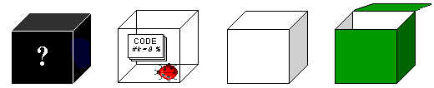
Testing Basics
Boxes
Black Glass White Clear
Open

Slide 6

Black Box Testing
We don’t care how something works, we just want to know if it works right.
“Requirements Based” Testing
Based on input and configurations.
Produces some output or effects.

Slide 7
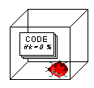
Glass/White Box Testing
Look at the code.
Follow the flow and branches in the code.
Usually done by programmers during unit testing.

Slide 8
Black Box Testing
PROS
  Can be done by users
  Tests business functions.
  Validates the specs.
CONS
  Requires specs or at least a user manual
  Could miss blocks of code
  Could over test things if you don’t know about the implementation

Slide 9
Glass/White Box Testing
PROS
  Picks up extra code
  Can be used to force execution of a piece of code.
CONS
  Doesn’t test business functions
  Doesn’t test specs
  Not practical for large modules/systems
  Need access to the program
  The code must exist to plan and to test.

Slide 10
Doesn’t Test Specs?!
Test cases are often designed before code is written.
Test cases are reviewed with the client.
We can state the intended results from the requirements.
We can’t state the intended results from a particular chuck of code until the code is actually written.
The specs are re-thought in the context of testing.

Slide 11
User testing vs.
Programmer testing
Users are the people who know best whether it’s working right or not.
Glass Box testing doesn't involve users.

Slide 12
Testing in the lifecycle
Unit Testing
  Done by individual programmers
  Glass box testing or Black box testing
Integration Testing
  Done by integration programmers
  Black box testing
System Testing
  Done by users and programmers
  Black box testing

Slide 13

Testing is NOT a phase
There are testing activities that can be carried out throughout the development cycle.
Fatal Error: The Caboose

Slide 14

Involve Testing Early
It is essential that the requirements are testable.
When the requirements are written, QA needs to be involved in the testing process, as well as users.
Black box testing means that we have everything we need to design the tests as soon as we know what the system is supposed to do.

Slide 15
Risk-Driven Testing
Since we can’t test everything, we have to prioritize so that at least the most important things get tested.
In testing, there is never enough time or resources.

Slide 16
Risk-Driven Testing
Take the piece of your system, whatever you use - modules, functions, sections of requirements(1.2.1)- and rate each piece on two variables.
Impact
  What would happen if this piece somehow malfunctioned.
Likelihood
  Estimate of how probably it is that this piece would fail.

Slide 17
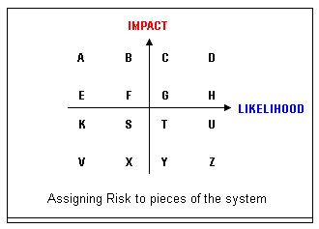
Impact vs. Likelihood

Slide 18
Impacts
Real World Effects
  Planes fall out of the sky
  Clients can’t submit orders
Computer Problems
  System is down
  Database is corrupted
Incorrect Output
  Numbers are wrong
Doesn’t meet expectations

Slide 19
Impact * Likelihood = Risk
Compute the risk for each piece.
How to use the risk?
  Make a list of bad things that could happen.
  List all the ways each bad thing could happen.
  Decide which tests you need to do to make sure that the bad things aren’t happening.
  Post the list where LOTS of people can see and add to it.
For high impact functions, need contingency plan.

Slide 20
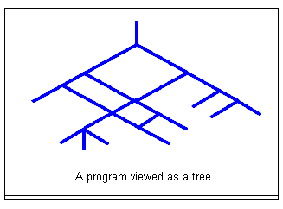
How many tests do we need?

Slide 21
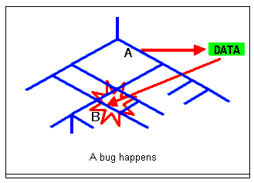
How bugs get missed?

Slide 22
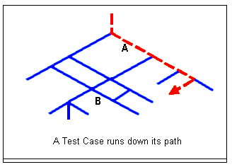
Paths through the program

Slide 23
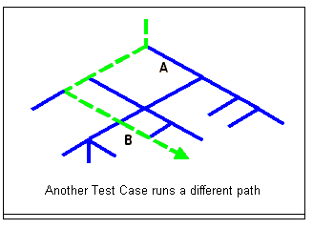
Another Path

Slide 24
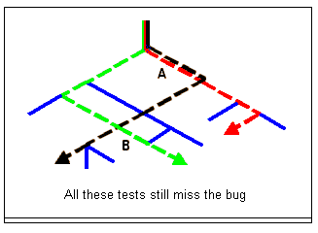
Yet another path

Slide 25
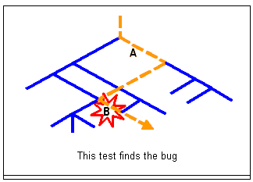
Bug is found

Slide 26
Path Coverage
In order to find the bug in the example, we'd have to test all the paths.
Path Coverage is what we'd like, but in the real world we're not going to get it except for very tiny programs (or pieces of programs).

Slide 27
Code Coverage
If we have a set of tests that gives Code Coverage, it simply means that, if you run all the tests, every line of the code is executed at least once by some test.

Slide 28
Data Coupling
Data Coupling is:
  One part of the code affecting another part of the code by modifying data.
Data Coupling creates the problem of too many tests.
Because of Data Coupling, we'd have to get Path Coverage to test completely.
Code Coverage is so much weaker than Path Coverage that it's often not of much use.

Slide 29
Software Testing in the Real World
Fundamental Problem:
  If the program has 70 branches (if-then-else), to do a complete path coverage requires 2⁷⁰ test cases!!
Programs with 70 branches aren’t very big!
Real world systems are much more complex.

